Slide 1
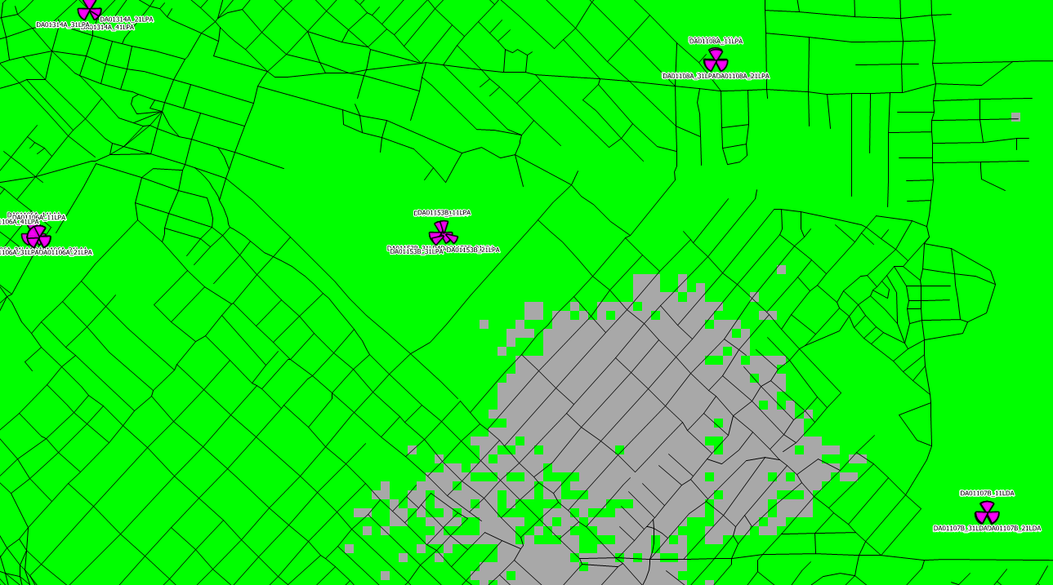
DA03058 – ACTUAL ZONE COVERAGE (RSRP)
CURRENT RSRP

Slide 2
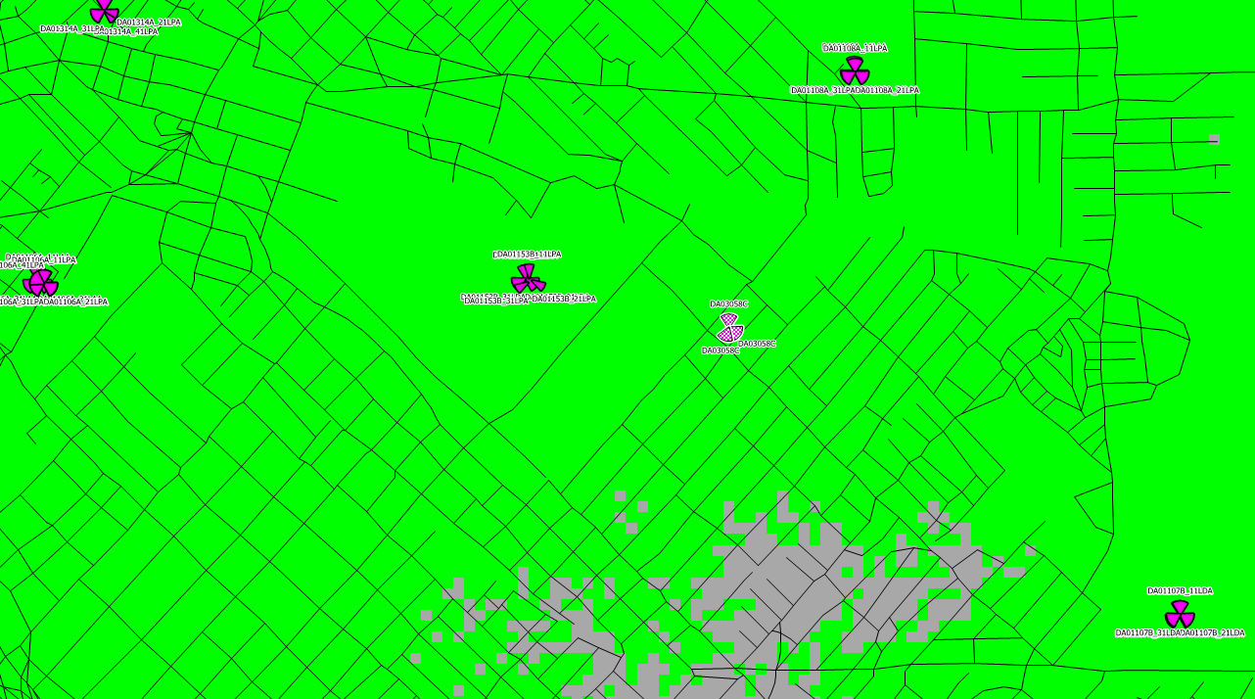
DA03058 – NEW COVERAGE @ 60’ (RSRP)
NEW RSRP

